Slide 1

Java - OOP
Presentation by: Norbert Paksi

Slide 2
Included topics
OOP Basics
Create own classes
Static variable
Static and dinamic functions
Extends

Slide 3

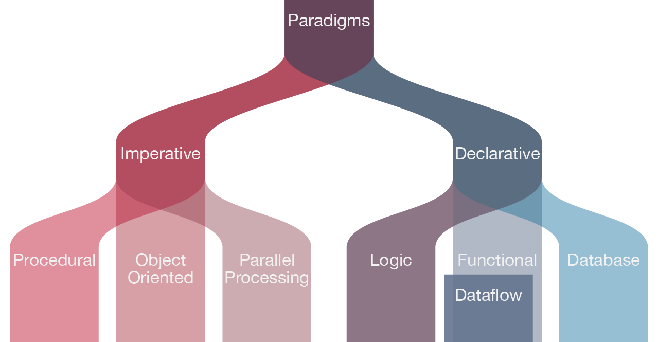
Find OOP in the big picture

Slide 4
What’s the goal with oop?
Definition of OOP: Create Classes and Objetsc to replicate the real work with this objects.

Slide 5
Basic concepts
Object
Class
Visibility
Property

Slide 6

Class
By create a class, we can plan the section of a future object, which will functioning perfectly.

Slide 7
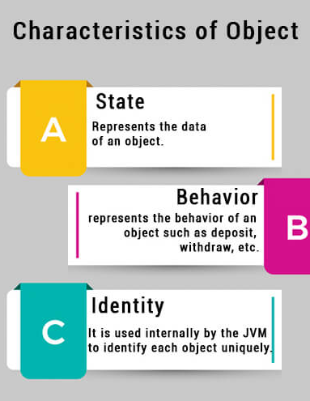
Object
A Java object is a combination of data and procedures working on the available data. An object has a state and behavior.
The state of an object is stored in fields (variables), while methods (functions) display the object's behavior. Objects are created from templates, we know as classes.

Slide 8
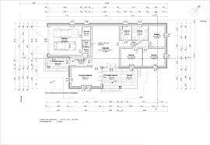
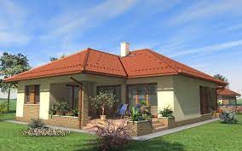
Class -> Object

Slide 9
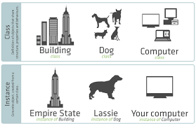

Slide 10
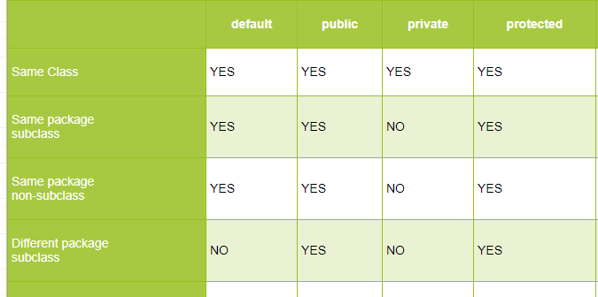
Visibility / Acces modifiers
Access modifiers are keywords that set the accessibility of classes, methods, properties, etc.

Slide 11
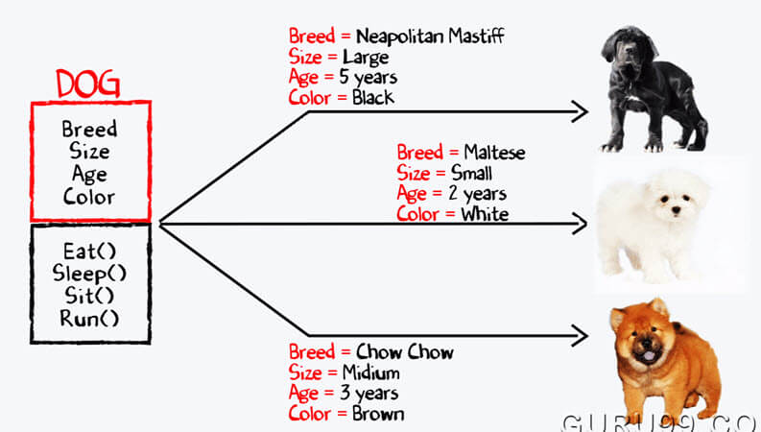
Property
With multiple properties, our object will store more elementary data (Like collections does) in one object.
Syntax of a well defined property: Visibility Data-type Property-name

Slide 12




Types of Property
Unvisible
Visible, but unable to change
Changeable
Limited change

Slide 13
Getters and Setters
Getter and Setter are the grouping name of functions we define to create access to states/properties with limited/restricted.
Getter will return the exact data , like .get() in Lists.
Setter will change the stored value in the current property, like .set()

Slide 14




Get function
Private property
Public getter()
Different class

Slide 15

Set function
Private property
Public setter()
Different class

Slide 16




Setter types
Changeable to any value
Confined / limited
Switch on – off / 2 positions
Unable to set

Slide 17
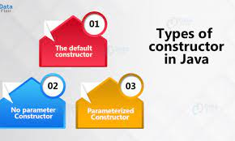
Construct
Function to use when declarate an object
Could be multiple ones in the same class
Generated in runtime if we didn’t define any

Slide 18
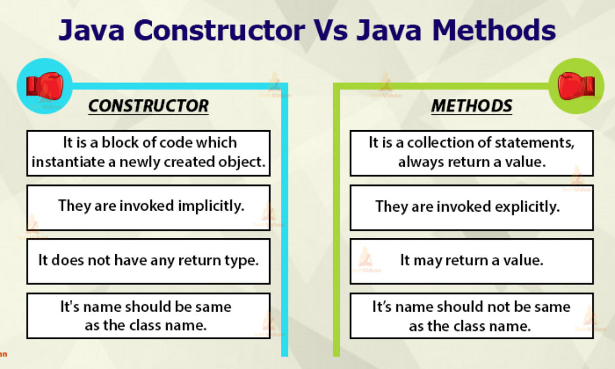

Slide 19
Source code example
Lets jump to NetBeans, and create a simple class

Slide 20

Static variable

Slide 21
Created once, stored in the class (not in the object like simple (dinamic) properties)
All object that created by a class, shares this static variable
Also known as class variables
Can be accessed directly in both static and non-static methods

Slide 22
Source code example
Lets jump to NetBeans, and add a static variable to our class

Slide 23

Enum in classes

Slide 24
What is Enum?
Enum is a special collection that represents a group of constants values.
Creatable by the enum keyword
Named after enumerations
Can have attributes and methods just like classes, but in the enums, everything is public static and final.
Can be placed both inside and outside a class

Slide 25
Enum with single values
Example: Enum Level { LOW, MEDIUM, HIGH }

Slide 26
Loopable with foreach loops
Read out one constans value: Level value = Level.HIGH;

Slide 27
Enum with properties
Enumcan hold complex values too
Complex values have a name (like variable name of an object), and this „Object” contains properties
Because of the properties, enum also have a contruct
Can contains static variables

Slide 28
Source code example
Lets jump to NetBeans, and create an enum with complex values.

Slide 29

Static vs Dinamic functions

Slide 30
Dinamic function
Called on one object
Can see the input parameters, and the object which is the subject of the call
Can access subject of the call obejct whit the name: „this”

Slide 31
Dynamic function examples
Get
Set
.Equals
Etc.

Slide 32
Static function
Can be called on the class
Can see input parameters only

Slide 33
Static function examples
We don’t know any static function yet, so lets jump to netbeans and create a few.
We will also see the difference between static and dynamic functions.

Slide 34
Extends

Slide 35
Definition:
The extends keyword extends a class (indicates that a class is inherited from another class). In Java, it is possible to inherit attributes and methods from one class to another. ... subclass (child / derived) - the class that inherits from another class. superclass (parent / base) - the class being inherited from.

Slide 36
Rules of extends:
Every subclass can extend only one superclass
Superclass can extend another superclass (chain of inheritance)
In superclass, you better use the protected visibility

Slide 37

Types of Inheritance

Slide 38

Single inheritance

Slide 39
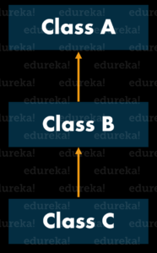
Multi-level Inheritance

Slide 40
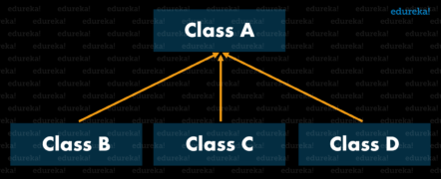
Hierarchical Inheritance

Slide 41
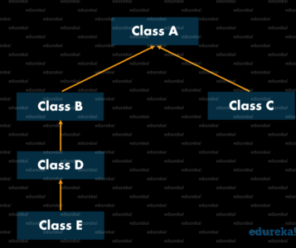
Hybrid Inheritance

Slide 42

Abstract class
Abstract class: is a restricted class that cannot be used to create objects (to access it, it must be inherited from another class).

Slide 43


PET SUPERCLASS
BARK
MEOW
EAT
EAT
WALK
SLEEP ALL DAY
RUN

Slide 44
How object built with extend
PET SUPERCLASS | DOG SUBCLASS | DOG OBJECT
Age | Sound | Age
Name | Type | Name
 | Gender | Sound
 |  | Type
 |  | Gender

Slide 45
Super keyword
If we declarate a dog object in the current example, we sould somehow connect the superclass construct.
We can connect it with super(), like this:
Public dog(int age, String name,String sound,String type,String gender){ super(age,name); this.sound = sound; this.type = type; this.gender = gender ; }

Slide 46
Getter and Setter?
As we already see, we can extends construct, and yes, subclass is extend getter setter, and other created functions of superclass too.

Slide 47
@Override
If you have 10 subclass, all 10 contains the same function, and 8 of them are define this function exactly the same, take this function to the superclass. Te last 2 times, use @override in the subclass, and simply define the function again, you will override the previus one in this current class, and didn’t create any change in every other classes.

Slide 48


